Slide 1
Certiport Certification Testing
Overview of First Steps & Tips

Slide 2
5 Steps to MOS Testing
Self-Register at Certiport and create a user account
1
2
Register your School as a Testing Center
3
Accepting site license
4
Lab Set up: items to note
5
Console 8

Slide 3
Registering Yourself at Certiport
Go to www.certiport.com and register yourself.
If you have previously registered do not register again – go to the next slide
Tip: During the Account set up if you will be proctoring we recommend creating a short username and password that will be easily remembered
Tip: During registration if you will be proctoring please accept the proctoring agreement during the Choose a Purpose page in the registration process
Notes:
Registration – and students need to register

Slide 4
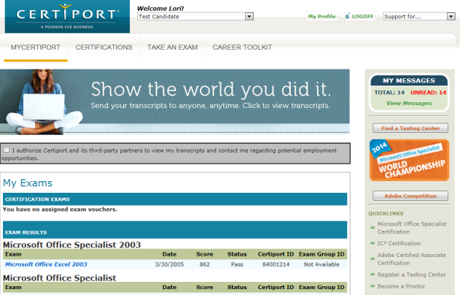
Registering Your Institution
After you personally register, you will have a test candidate role under Welcome at the top.
Click on “Register a Testing Center” (only one person to take responsibility)

Slide 5
Site Registration
First Page of Form
Please proceed filling out the form
Tip: You only need to fill in the * fields
Tip: The primary contact information will auto fill with your information
Tip: Accounts Payable field is required for contact reasons if your institution chooses to purchase other products from Certiport. Usually your CTE Director

Slide 6
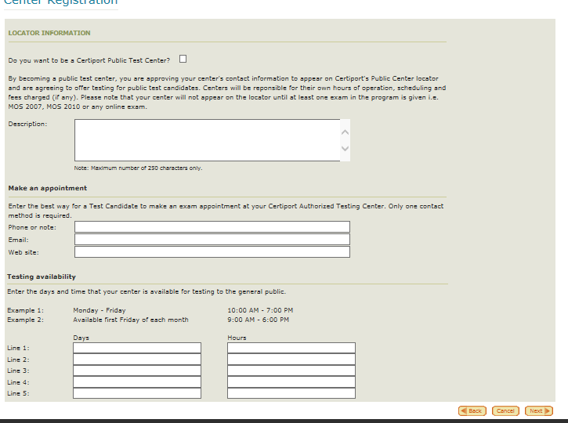
Site Registration con’t
Public Center:
This will allow your site to appear on our testing center locator for a test candidate to find a testing center location near them.
K12 defaults to no, leave all fields blank, just click “next”

Slide 7
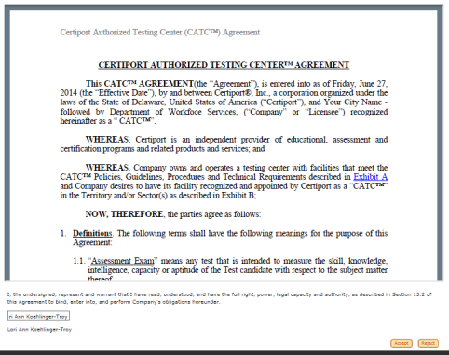
Final Registration Page
To complete the Testing Center Registration you must view and accept the Testing Center Agreement. You may print at any time during registration or after.
Please enter your name in the box EXACTLY as it is written below.
Click Accept
Tip: A snapshot of a section in the agreement. This section is waived as the product has already been purchased on your behalf.

Slide 8
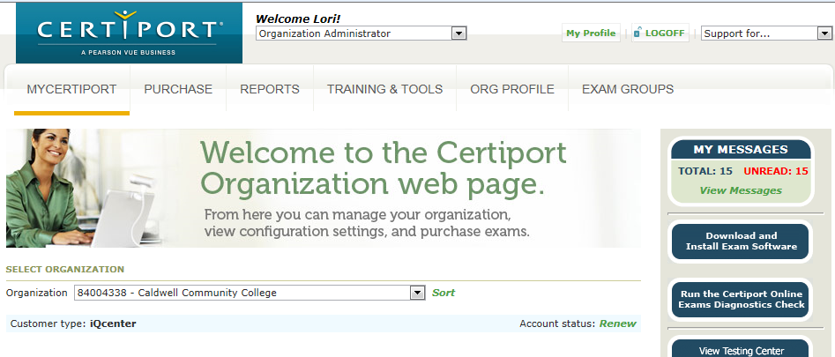
Your Testing Center Portal

Slide 9
Setting up Administrators
Everyone registers at Certiport to have access to the portal
Teachers – reports / proctoring
CTE Staff – reports
IT Staff – to install the testing engines
Proctoring: in addition to accepting the proctoring agreement when you registered you must also check the proctor box on the association page.
Main Admin will need to add any proctors to the account manually by searching their username in the “Find Users” area
Where to find: Log in as an Organizational Administrator, hover over “Org Profile” and click on “Associations”
Tip: If registered but not signed the proctor agreement login at www.certiport.com click on “my profile” click on “roles” tab.

Slide 10
Activating the Site License
Exam Site License of 500 exams
To administer exam, must accept the site license agreement
Log in to Certiport; select Org Admin
Hover My Certiport and click on License
Once you accept the agreement, “accept” will turn to “view” and status will be “active” and the white dot will turn green

Slide 11
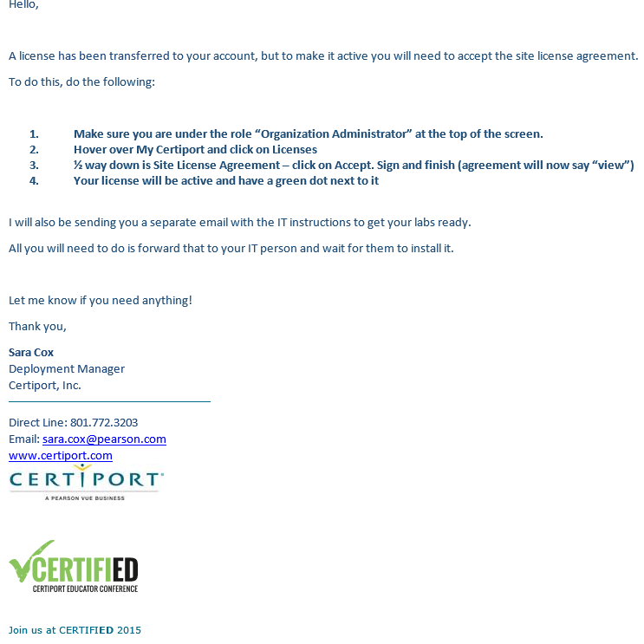

Slide 12
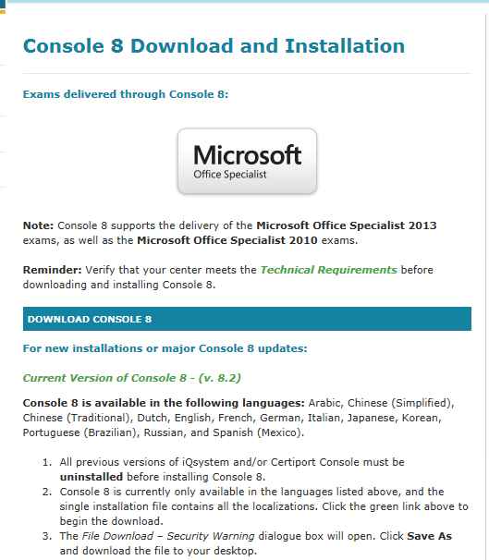
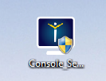
Preparing the Lab - IT
In order to take Microsoft Exams, Certiport’s testing engine , Console 8 must be installed.
To install:
The person must have full local administration rights to the computer
They must be associated to the testing center
Log in to Certiport; select Org Member
Hover over Training & Tools click on Console 8
Review Technical Requirements
Download the testing engine
Complete the User Rights after installation

Slide 13
Lab Set Up: Items to Note
MS Office Certification exams runs on concurrent technology: Office Professional Software needed
Office Software needs to be installed at 32Bit
Schools can test on MAC as long as the computers are partitioned
Group Policies should be removed
Any type of Restoring Software (deep freeze) is recommended to be disabled during testing day
New Lan Solution (Questions contact tech support 1-888-999-9830 x9)

Slide 14
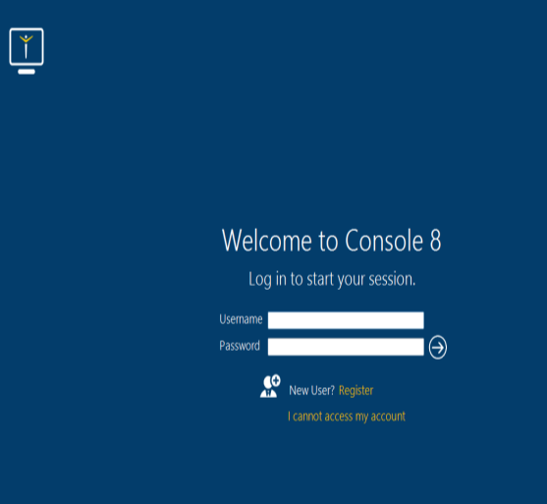
Console 8
Notes:
New images of Console icon needed.

Slide 15
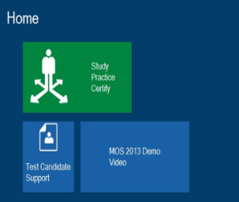
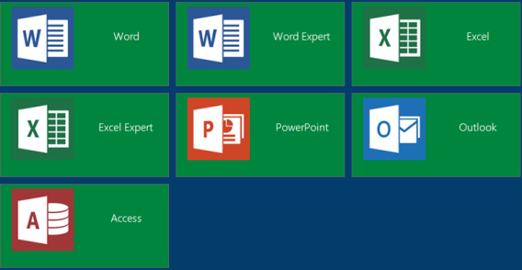
Console 8
Payment Method:
Defaults to your license
Exam Group:
Optional report

Slide 16
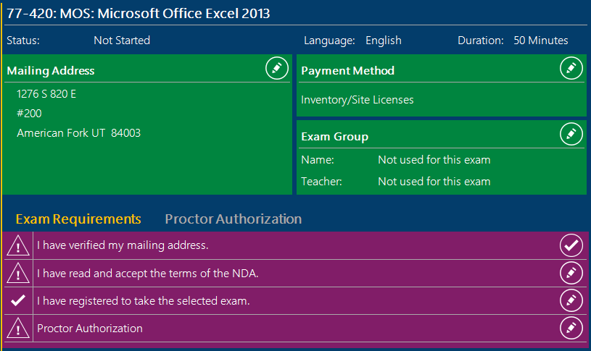
Console 8
Proctor
Students will verify their information and agree to the NDA agreement by clicking on the icons to the right of the options. (Goal is to have all checks on the left hand side)
If the student did not register to take the exam (during the student registration a form will pop up)
Teacher/proctor will enter proctor information
Exam will begin with instructions

Slide 17
Signing in as Proctor
“Proctor Authorization.”
You will need to go to each student’s computer who is taking the exam.
Verify your student name, exam they are taking and your school name.
If correct, check the box and type your Certiport username and password
Click the arrow and go! Good luck!
The exam is 50 minutes long. The exam will begin with the instructions
Timer begins when the 1st question appears

Slide 18
Quick Review
Registration:
Individual
School
Everyone who will need to proctor exams, run reports and download the software needs to be associated to the testing center
Tab: Org Profile – Associations
Accept Site License
Tab: MyCertiport - Licenses
Testing software will need to be downloaded on each testing computer
Tab: Training and tools-Console 8

Slide 19
Thank you
Customer Service / Tech Support
1-888-999-9830 #9
Sara Cox
801-772-3203
Sara.cox@pearson.com

