Slide 1
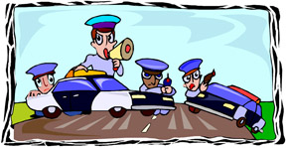
Felony Traffic Stops
Law Enforcement I

Slide 2
Copyright and Terms of Service
Copyright © Texas Education Agency, 2011. These materials are copyrighted © and trademarked ™ as the property of the Texas Education Agency (TEA) and may not be reproduced without the express written permission of TEA, except under the following conditions:
1) Texas public school districts, charter schools, and Education Service Centers may reproduce and use copies of the Materials and Related Materials for the districts’ and schools’ educational use without obtaining permission from TEA.
2) Residents of the state of Texas may reproduce and use copies of the Materials and Related Materials for individual personal use only, without obtaining written permission of TEA.
3) Any portion reproduced must be reproduced in its entirety and remain unedited, unaltered and unchanged in any way.
4) No monetary charge can be made for the reproduced materials or any document containing them; however, a reasonable charge to cover only the cost of reproduction and distribution may be charged.
Private entities or persons located in Texas that are not Texas public school districts, Texas Education Service Centers, or Texas charter schools or any entity, whether public or private, educational or non-educational, located outside the state of Texas MUST obtain written approval from TEA and will be required to enter into a license agreement that may involve the payment of a licensing fee or a royalty.
Contact TEA Copyrights with any questions you may have.

Slide 3
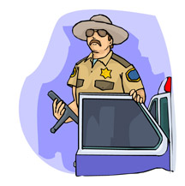
When are they done?
Felony Traffic Stops are performed when
There is a felony warrant
The vehicle is stolen
There is a threat to officer safety

Slide 4
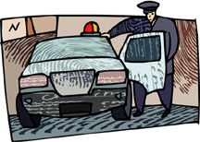
Positioning
Positions of Vehicles and Officers
Officer vehicles are parked side-by-side.
Officers take cover behind the vehicle door.

Slide 5
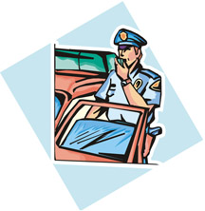
Procedures
The primary officer commands the driver to:
Put his hands out of the window
Throw the keys out of the window
Open the door from the outside with his left hand

Slide 6
Procedures (continued)
The primary officer commands (continued)
Lift up his or her shirt and turn around
Face away from the officer and walk backwards to the sound of the officer’s voice
Take a few steps to the right, when the suspect is close enough
Stop and get on his or her knees or stomach

Slide 7
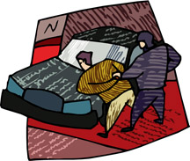
Procedures (continued)
The backup officer
Arrests the suspect
Takes the suspect to his car
Searches the suspect

Slide 8
Procedures (continued)
The primary officer
Gives the commands to get out again
Stays out of crossfire zone
Opens the trunk

Slide 9
Priorities
Only the primary officer gives commands.
Communication among the officers is key.
The primary officer must say, “Do it now,” after each command.

Slide 10
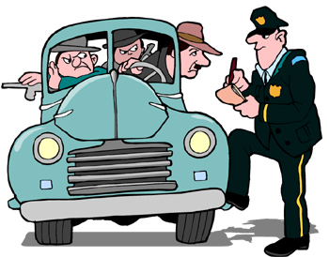
Other Scenarios
When there is more than one person in the vehicle, wait until the driver is in the squad car before getting the other occupants out of the vehicle.

Slide 11
Other Scenarios (continued)
When there is a gun in the suspect's waistband, let him or her know that you see it and you will shoot if he or she reaches for it.

Slide 12
Resources
Texas Commission on Law Enforcement Officers Standards and Education (TCLOESE) Training
Officer’s experience on-the-job
Do an Internet search for the following:
Traffic stops too dangerous for one former officer
Police Explorer felony vehicle stop
High risk traffic stop

