Slide 1
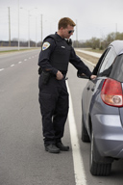
Basic Traffic Stops
Law Enforcement I

Slide 2
Copyright and Terms of Service
Copyright © Texas Education Agency, 2011. These materials are copyrighted © and trademarked ™ as the property of the Texas Education Agency (TEA) and may not be reproduced without the express written permission of TEA, except under the following conditions:
1) Texas public school districts, charter schools, and Education Service Centers may reproduce and use copies of the Materials and Related Materials for the districts’ and schools’ educational use without obtaining permission from TEA.
2) Residents of the state of Texas may reproduce and use copies of the Materials and Related Materials for individual personal use only, without obtaining written permission of TEA.
3) Any portion reproduced must be reproduced in its entirety and remain unedited, unaltered and unchanged in any way.
4) No monetary charge can be made for the reproduced materials or any document containing them; however, a reasonable charge to cover only the cost of reproduction and distribution may be charged.
Private entities or persons located in Texas that are not Texas public school districts, Texas Education Service Centers, or Texas charter schools or any entity, whether public or private, educational or non-educational, located outside the state of Texas MUST obtain written approval from TEA and will be required to enter into a license agreement that may involve the payment of a licensing fee or a royalty.
Contact TEA Copyrights with any questions you may have.

Slide 3
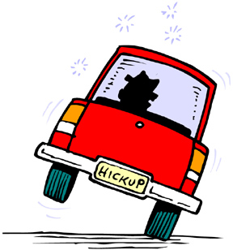
Before The Stop
Observes a violation
Responds to a call involving criminal activity and finds the suspect vehicle
Has a reasonable suspicion

Slide 4
Before The Stop (continued)
Picks a safe spot to initiate a traffic stop
Turns on the lightbar
Dispatches information over the radio
Location
License plate
Anything else dispatch may need to know
Number of occupants
Color and type of car
Unusual and/or suspicious activity

Slide 5
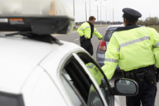
Before The Stop (continued)
Positions the vehicle
To the left of the violator
Turned towards the left
Observes the occupants while looking for unusual movement

Slide 6
Before The Stop (continued)
Observes the occupants looking for unusual movement
Shines a spotlight into the center of the vehicle or the driver's side mirror, if performing the traffic stop at night
Remembers the importance of keeping the element of surprise
Uses various approaches when necessary

Slide 7
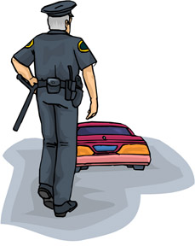
During The Stop
The officer, during the approach:
Moves toward the violator quickly
Looks for oncoming traffic before exiting the vehicle
Confirms the possession of all essential equipment (flashlight, notepad, pen, etc.)‏
Checks the trunk
Stands at an advantageous position (behind or in front)

Slide 8
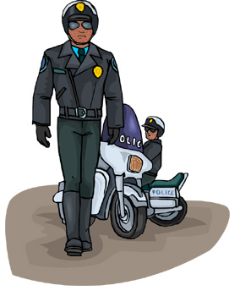
During The Stop (continued)
The officer uses the 7 Step Method:
Greets and shows identification
States the violation that was committed
Asks for the driver’s identification
States an action before it is taken
Takes the stated action
Explains what the violator must do
Leaves

Slide 9
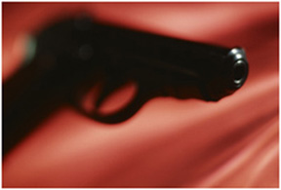
During The Stop (continued)
The officer must:
Maintain sight of the violator’s hands
Look for weapons or contraband in plain view

Slide 10
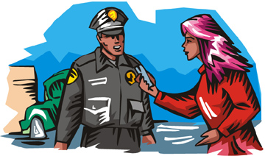
During The Stop (continued)
The officer obtains:
Driver's license or identification card
Correct information, avoiding the name game
Proof of insurance

Slide 11
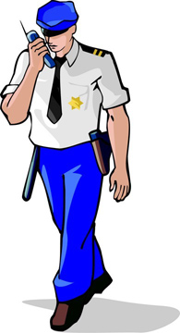
During The Stop (continued)
Returns to vehicle
Runs the information
Writes the ticket, confirms the warrant, etc.

Slide 12
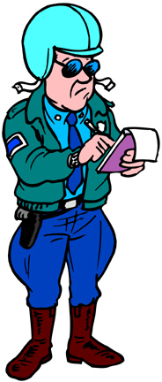
During The Stop (continued)
Gives a verbal warning or writes a ticket
Returns to the violator and gives a warning or ticket
Says, “You are receiving a ticket.”
Does not say, “I am giving you a ticket.”
Thanks the violator for exhibiting courtesy and cooperation

Slide 13
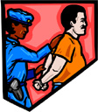
During The Stop (continued)
Discovers a warrant and arrests the violator
Has dispatch confirm the warrant
Requests backup
Keeps an eye on the occupants
Follows the steps of warrant arrest

Slide 14
During The Stop (continued)
The steps of warrant arrest
Approaches the driver and has him or her step out to the back of the vehicle when backup arrives
Makes the arrest
Releases the vehicle to a third party
Leaves the vehicle parked in a secure area
Impounds the vehicle if it is a traffic hazard
Performs an inventory
Takes the violator to jail

Slide 15
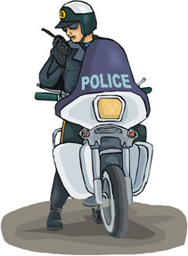
After The Stop
Clears with a disposition on the radio
Verbal warning
Ticket
En route to jail

Slide 16
Passengers
Passengers may:
Give their information if you ask
Refuse to give requested information
Exit the vehicle and leave because the driver is the only one detained

Slide 17
Possible Scenarios
The officer smells
Marijuana
Has the violator step out of the vehicle and calls for backup immediately
Searches for marijuana wherever it may be hidden

Slide 18
Possible Scenarios (continued)
The officer smells
Alcoholic beverage
Takes the keys out of the ignition if necessary
Calls for backup
Administers Standardized Field Sobriety Tests (SFSTs)

Slide 19
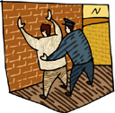
Possible Scenarios (continued)
The officer sees a gun on the passenger seat
Draws his or her weapon
Has the occupant exit the vehicle
Puts the violator in handcuffs
Performs a Terry Stop or Frisk

Slide 20
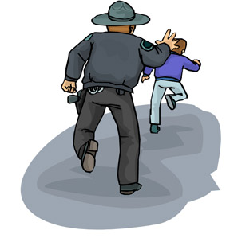
Possible Scenarios (continued)
The officer observes fervent movement, and then searches the area as a safety precaution
The driver jumps out of the vehicle due to extreme emotion (anger, confusion, etc.); the officer has them get back into the vehicle

Slide 21
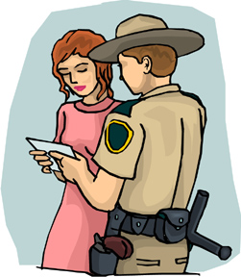
Some Reactions of Drivers
Non-responsive
Accusations of racial motivation
Passive
Mixed/combination
Crying/emotional
Verbally Angry
Physically Angry
Totally Compliant

Slide 22
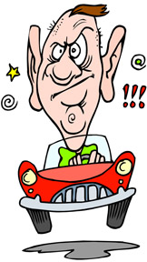
Expected Reactions of Drivers
Nervousness (is normal)
Extreme Nervousness (something else is going on)
Disrespectful
Making racial accusations
Complaining
Verbally abusive
Does not take it personally
Appreciates the humor when appropriate
Nice and respectful until a ticket is received

Slide 23
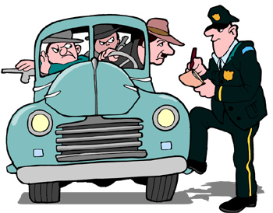
Expected Reactions of Drivers (continued)
Always remember that there is no such thing as a routine traffic stop.

Slide 24
Officer Radio Procedures
Identifies him or herself
Tells dispatch when he or she is on a traffic stop by using the code “4111 traffic”
Waits for dispatch to acknowledge, and then gives the location of the traffic stop
Tells dispatch the license plate twice

Slide 25
Call Letters
A | Adam | H | Henry | O | Ocean | V | Victor
B | Boy | I | Ida | P | Paul | W | William
C | Charles | J | John | Q | Queen | X | X-Ray
D | David | K | King | R | Robert | Y | Young
E | Edward | L | Lincoln | S | Sam | Z | Zebra
F | Frank | M | Mary | T | Tom
G | George | N | Nora | U | Union

Slide 26
Officer Radio Procedures (continued)
Gives any other pertinent information such as the number of occupants, suspicious movements or items, etc.
Waits for dispatch to respond and then makes an approach
Says “4111 check one” after making initial contact
Waits for dispatch to respond

Slide 27
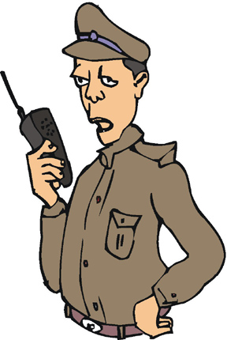
Officer Radio Procedures (continued)
Gives dispatch the persons:
Last name
First name
Date of birth
Sex and Race
Waits for dispatch to acknowledge by calling his or her officer number
Responds with, “Go ahead”
Listens for dispatch response
Says, “4111 receive”

Slide 28
Officer Radio Procedures (continued)
If dispatch informs the officer that the violator has a warrant and the officer decides to arrest the violator, the officer says, “Go ahead and confirm the warrant”
After completing the stop and returning to the squad car the officer says, “4111 is clear traffic with a (ticket or warning or arrest)”

Slide 29
Resources
Texas Commission on Law Enforcement Officers Standards and Education (TCLOESE) Training
Officer’s experience on-the-job
Do an Internet search for the following:
Deputy shot in the face and lives
Texas Officer assaulted on traffic stop video

