Slide 1
Community- Oriented Policing
Law Enforcement I

Slide 2
Copyright and Terms of Service
Copyright © Texas Education Agency, 2011. These materials are copyrighted © and trademarked ™ as the property of the Texas Education Agency (TEA) and may not be reproduced without the express written permission of TEA, except under the following conditions:
1) Texas public school districts, charter schools, and Education Service Centers may reproduce and use copies of the Materials and Related Materials for the districts’ and schools’ educational use without obtaining permission from TEA.
2) Residents of the state of Texas may reproduce and use copies of the Materials and Related Materials for individual personal use only, without obtaining written permission of TEA.
3) Any portion reproduced must be reproduced in its entirety and remain unedited, unaltered and unchanged in any way.
4) No monetary charge can be made for the reproduced materials or any document containing them; however, a reasonable charge to cover only the cost of reproduction and distribution may be charged.
Private entities or persons located in Texas that are not Texas public school districts, Texas Education Service Centers, or Texas charter schools or any entity, whether public or private, educational or non-educational, located outside the state of Texas MUST obtain written approval from TEA and will be required to enter into a license agreement that may involve the payment of a licensing fee or a royalty.
Contact TEA Copyrights with any questions you may have.

Slide 3
What is Community-Oriented Policing?
Community Oriented Policing (COP) is:
Decentralized policing programs that focus on
Crime prevention
Community quality of life
Public order
Alternatives to arrest

Slide 4
What is Community-Oriented Policing?
Problem-Oriented Policing (associated with COP) is:
A proactive type of community policing that focuses on solving the underlying problems of delinquency and crime

Slide 5
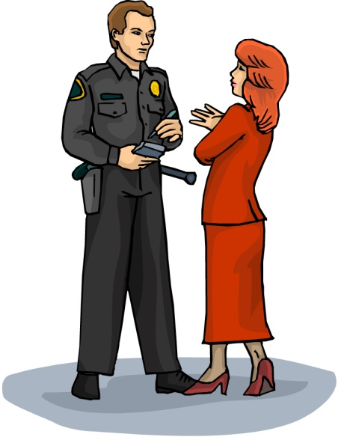
Characteristics of COP
Focus is on proactive crime prevention rather than emergency response
Encourages officers to see citizens as partners
Shifts decision-making downward to patrol officers
More visible operations

Slide 6
Traditional
Law Enforcement
COP
Rapid response
Crime investigation
Apprehension of criminal
Law enforcement
Responding to symptoms
Strategies that promote crime prevention
Promote community quality of life and public order
Use of alternatives to arrest and force to solve the problem

Slide 7
Origin of COP
Events of the 1960’s
Police Research
Presidential Commissions
Data findings
Recommendations

Slide 8
Data Findings
Analysis of crime statistics showed that the current emphasis on crime fighting has had a limited effect on reducing crime.
Police isolation
Prevented strong ties to the community
Hampered crime-fighting efforts
Resulted in ignorance of unreported crimes

Slide 9
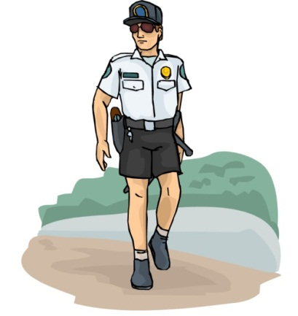
Data Findings (continued)
Randomized patrol had a limited impact on crime
A large portion of serious crimes were not deterred by rapid response
There was less friendly foot patrolling because of the reimplementation of automobiles

Slide 10
Data Findings (continued)
Answering the high number of 911 calls overwhelmed the police and left them little time for crime prevention
Detectives solved only a small percentage of the crimes; the majority of solved cases hinged on information obtained by patrol officers

Slide 11
Recommendations
Need for formal call-screening procedures to differentiate between emergency and nonemergency calls
When not handling calls, the officers could more profitably spend time addressing specific criminal activities, instead of performing randomized patrols.
Police could identify the community “hot spots” and reduce the number of repeated calls to these locations.

Slide 12
Recommendations (continued)
Patrol officers should become knowledgeable about their beats through “beat-profiling” activities (studying the demographics and call histories).
Officers should develop “tailored patrol” strategies to address the types of crime and citizen concerns revealed by their profiling activities.
Officers must be assigned to permanent shifts and beats if they are to participate in community activities.

Slide 13
Benefits of COP
Interaction can improve the attitudes of officers toward their jobs and the communities they serve, which encourages the officers to develop creative solutions to complex problems.

Slide 14
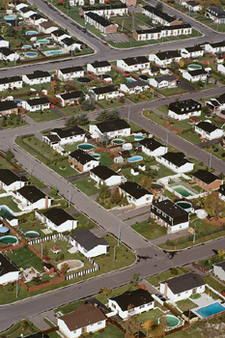
Benefits of COP (continued)
Officers are able to obtain valuable information about criminal activity and perpetrators by getting to know members of the community.
Officers can obtain realistic assessments of community members’ needs and their expectations of police services.

Slide 15
Challenges of COP
Decentralization of decision-making
Officers are more comfortable with a structured leadership.
Need for retraining
This can be a huge shock to traditional officers who see the public as their enemy.
Crime displacement versus elimination
Is crime eliminated or moved to another part of the community that is less vocal about it?

Slide 16
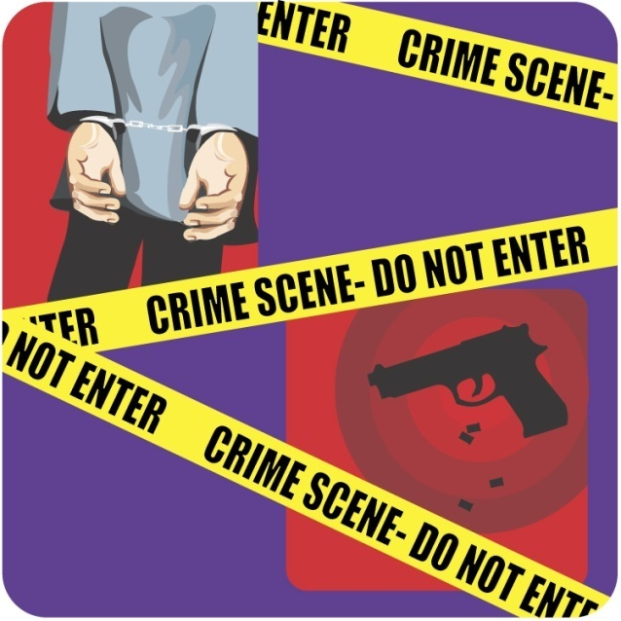
Challenges of COP
Acceptance by biased communities who may have a preconceived, negative stereotype of police
Tyranny of neighborhoods
Suppresses persons who are considered objectionable

Slide 17
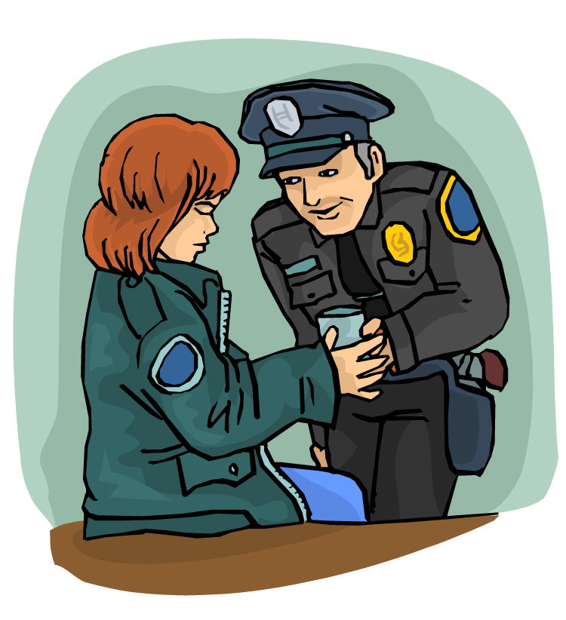
Skills Needed
Attentive
Non-judgmental
Effective communication
Resourceful
Open-minded
Flexible to change
Problem-solving
Hard-working
Outgoing

Slide 18
S.A.R.A., a COP Method
Scanning – gather data to define the problem
Analysis – determine the nature of the problem, causes, and possible solutions
Response – work with people, groups, and agencies to implement solutions
Assessment – follow up on the initiatives taken

Slide 19
Resources
U.S. Department of Justice http://www.ncjrs.gov/pdffiles/commp.pdf
National Center for Community Policing http://www.cj.msu.edu/~people/cp/20year.html
Community Oriented Policing Services http://www.cops.usdoj.gov/Default.asp?Item=36
020547893X, Criminal Justice (Second Edition), James A. Fagin

