Slide 1
History of Law Enforcement Law Enforcement I

Slide 2
Copyright and Terms of Service
Copyright © Texas Education Agency, 2011. These materials are copyrighted © and trademarked ™ as the property of the Texas Education Agency (TEA) and may not be reproduced without the express written permission of TEA, except under the following conditions:
1) Texas public school districts, charter schools, and Education Service Centers may reproduce and use copies of the Materials and Related Materials for the districts’ and schools’ educational use without obtaining permission from TEA.
2) Residents of the state of Texas may reproduce and use copies of the Materials and Related Materials for individual personal use only, without obtaining written permission of TEA.
3) Any portion reproduced must be reproduced in its entirety and remain unedited, unaltered and unchanged in any way.
4) No monetary charge can be made for the reproduced materials or any document containing them; however, a reasonable charge to cover only the cost of reproduction and distribution may be charged.
Private entities or persons located in Texas that are not Texas public school districts, Texas Education Service Centers, or Texas charter schools or any entity, whether public or private, educational or non-educational, located outside the state of Texas MUST obtain written approval from TEA and will be required to enter into a license agreement that may involve the payment of a licensing fee or a royalty.
Contact TEA Copyrights with any questions you may have.

Slide 3
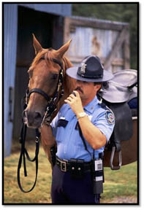
Police In A Democratic Society
The police are entrusted to serve and protect the public by controlling and preventing crime.
Uniformed officers are typically the citizen’s most common and direct contact with law enforcement.

Slide 4
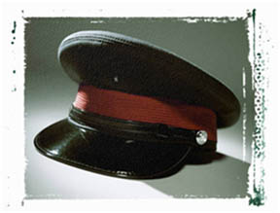
Early Civilization
Law enforcement
Extends back to the earliest human civilizations
Was a social need for promoting the group’s well-being

Slide 5
Early Civilization (continued)
Banishment was the most effective means of deterring or punishing deviant behavior because it was the equivalent of a death sentence.
The camp guards of early civilization represent the first traces of law enforcement practices. Their function was similar to our present-day police.

Slide 6
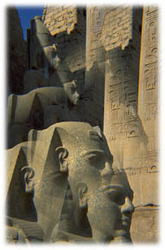
First recorded police organization
Traced back to the reign of Pharaoh Hur Moheb, around 1340 B.C., in Egypt

Slide 7
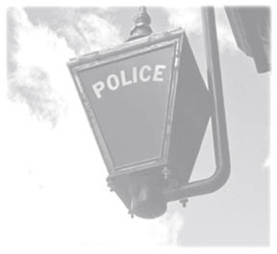
Origin of the word “Police”
Police is a derivative of the Greek word “Politeria.”
Politeria is the portion of government that deals with:
Protection of life and property
Preservation of peace and order
Prevention and suppression of crime

Slide 8
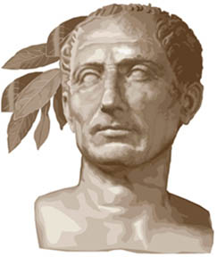
Roman Contribution
Occurred during the reign of Emperor Augustus Caesar

Slide 9
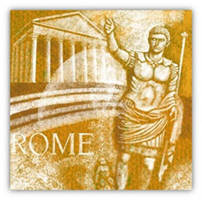
Roman Contribution (continued)
The police were a special feature of the Roman government with a special staff and various grades of officers.
Their main function was the maintenance of order and security.

Slide 10
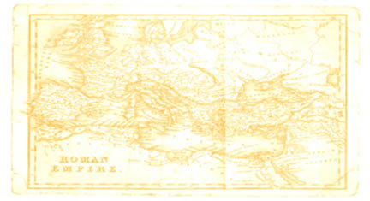
Roman Contribution (continued)
The police were divided into seven divisions with fourteen districts.
These districts represent the first city police precincts, a system still used today.

Slide 11
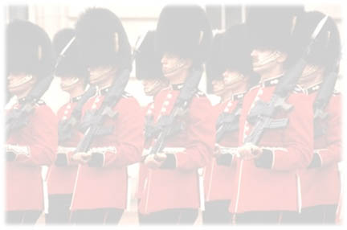
English Roots
American law enforcement concepts originated in England around 900 A. D.
Justice was primarily a private matter sought by victims and/or their family members, and based on revenge and retribution.

Slide 12
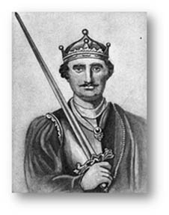
Frankpledge System and Tithing
King William, following the Norman Conquest in 1066, instituted a form of community policing called the frankpledge system.
Every male over twelve years of
age was required to form a group
of ten families called a tithing.

Slide 13
Shires, Shire Reeve, and Constable
In the larger areas of land, ten tithings were grouped together to form a group of one hundred. This hundred was called a shire.
The top law enforcement official was known as the shire reeve.

Slide 14
Shires, Shire Reeve, and Constable (continued)
The shire reeve
Was the beginning of the American sheriff
Was often assisted by the constables who organized posses to chase and apprehend criminals

Slide 15
Night Watch System
In 1285, the statute of Winchester passed, establishing the night watch system of protection.
One man from each parish was selected as constable.

Slide 16
Night Watch System (continued)
The constable would draft citizens as watchmen to guard the city at night.
These citizens were not paid, and often were found not doing their job.

Slide 17
Justice of the Peace
In 1326, the shire reeve was replaced with the office of the justice of peace.
Supervised various law enforcement activities including:
investigating crimes,
securing criminals for trial
organizing night watch system

Slide 18
Justice of the Peace (continued)
This system lasted well into the 1700’s.
Two important aspects of this system include:
the citizens were the police, and
the law enforcement organization was local.
These ideals carried over to the American colonies.
In the mid 1700’s, London still did not have an efficient system of law enforcement, so the military was used for crime control.

Slide 19
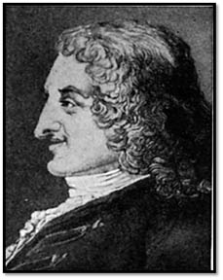
Henry Fielding
In 1748, Henry Fielding, a London magistrate, founded “The Bow Street Runners”, a group of law enforcement agents who apprehended criminals and recovered stolen property from the entertainment district.

Slide 20
Bow Street Runners
More effective than any other law enforcement of its day.
Helped pave the way for a more professional and efficient response to crime and the apprehension of criminals.

Slide 21
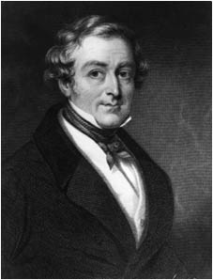
Sir Robert Peel
A more organized approach to law enforcement was needed due to:
Industrialization
Crowded cities
Crime increase
In 1829, Sir Robert Peel, and the English Parliament, mandated a publicly funded police force with the London Metropolitan Police Act.

Slide 22
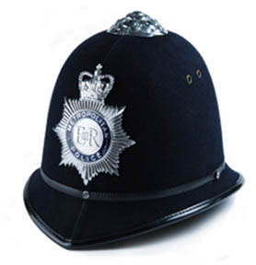
London Metropolitan Police Act
This act created a uniformed police force who became known as “bobbies,” or “peelers,” due to Peel’s influence in creating this force.

Slide 23
Peel’s 12 Principles of Policing
Sir Robert Peel believed the main function of the police was to prevent crime without force, by practicing preventive policing.

Slide 24
Peel’s 12 Principles of Policing (continued)
1) The police must be stable, efficient, and organized along military lines.
2) The police must be under government control.
3) The absence of crime will best prove the efficiency of the police.

Slide 25
Peel’s 12 Principles of Policing (continued)
4) The distribution of crime news is essential.
5) The deployment of police strength, by both time and area, is essential.
6) No quality is more indispensable to a policeman than a perfect command of temper; a quiet, determined manner has more effect than a violent action.

Slide 26
Peel’s 12 Principles of Policing (continued)
7) Good appearance commands respect.
8) The securing and training of proper persons is the root of efficiency.
9) Public security demands that every police officer be given a number.

Slide 27
Peel’s 12 Principles of Policing (continued)
10) Police headquarters should be centrally located and easily accessible to the people.
11) Policemen should be hired on a probationary basis.
12) Police records are necessary to the correct distribution of police strength.

Slide 28
Historical Eras of Law Enforcement
There are four major historical periods of law enforcement in the U.S.:
* Political Era
* Reform Era
* Professional Era
* Community Era

Slide 29
Political Era (1840-1920)
Police agencies were established to provide a unified police force in the major American cities.
“Spoils” system – the metropolitan police were powerful, corrupt, poorly trained, unsupervised, and frequently abusive to the public they were responsible to serve and protect.
The primary focus was on crime prevention and maintenance of order through the foot patrol.

Slide 30
Reform Era
Early part of the 20th century
Result of the middle and upper class citizens’ concern with corruption
These citizens wanted to:
Stop political patronage
Improve the efficiency of government, especially in law enforcement
Remove law enforcement from politics
Introduce modern technology to make law enforcement more efficient

Slide 31
Reform Era (continued)
Police administrative boards were established to reduce local political control over the police.
The civilian review boards were responsible for:
Appointing police administrators
Controlling police affairs
They failed because the appointed leaders often lacked law enforcement knowledge.

Slide 32
Professional Era (1920’s - 1970’s)
August Vollmer
Chief of police in Berkley, California
The most famous police reformer in the early part of the 20th century
Instituted university training for police officers
Helped to develop the School of Criminology at the University of California at Berkley
This school became the model for university-level criminal justice programs around the U.S.

Slide 33
August Vollmer (continued)
Believed that the police should be a professional force
The model of professional policing was developed from Vollmer’s six essential elements:
The police force should stay out of politics.
Members should be well-trained, disciplined, and tightly organized.
Laws should be equally enforced.
The police should use technological developments.
Merit should be on the basis of personnel procedures.
The crime-fighting role should be prominent.

Slide 34
O.W. Wilson
The redirection of police from maintenance of order to one of crime control altered the nature of policing in America more than any of the other elements of the professional era.
O.W. Wilson, a student of Vollmer’s, advocated that law enforcement use motorized patrols, radio communication, and rapid response to aid effective crime fighting.
He also suggested the use of one-man patrols as the best way to deploy police personnel, and the importance of rotating beat assignments in order to fight police corruption.

Slide 35
Community Era (1970 - present)
Research findings indicate that the professional model was not working:
Increasing the number of patrol officers in a neighborhood was found to have little effect on crime.
Rapid response to calls for service does not greatly increase the arrest of criminals.
It is difficult if not impossible to improve rates of solving crimes.

Slide 36
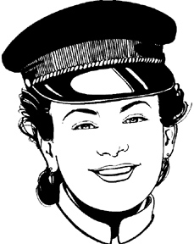
Service to the Community
In the 1970’s there was a movement away from the crime-fighting focus of law enforcement towards a greater emphasis on maintaining order and providing service to the community.
It was suggested that police officers get out of their patrol cars and spend more time on the street assisting citizens, while maintaining their crime-fighting role.

Slide 37
Resources
0205366937, Criminal Justice, Fagin, James A., Pearson, 2003
1598840436, Policing in America: A Reference Handbook, Steverson, Leonard A., ABC-CLIO, 2007
0072559519, Criminology (4th Edition), Adler, Freda, McGraw-Hill, 2001

