Slide 1
Elements of Crime and Categories of Punishment
Law Enforcement I

Slide 2
Copyright and Terms of Service
Copyright © Texas Education Agency, 2011. These materials are copyrighted © and trademarked ™ as the property of the Texas Education Agency (TEA) and may not be reproduced without the express written permission of TEA, except under the following conditions:
1) Texas public school districts, charter schools, and Education Service Centers may reproduce and use copies of the Materials and Related Materials for the districts’ and schools’ educational use without obtaining permission from TEA.
2) Residents of the state of Texas may reproduce and use copies of the Materials and Related Materials for individual personal use only, without obtaining written permission of TEA.
3) Any portion reproduced must be reproduced in its entirety and remain unedited, unaltered and unchanged in any way.
4) No monetary charge can be made for the reproduced materials or any document containing them; however, a reasonable charge to cover only the cost of reproduction and distribution may be charged.
Private entities or persons located in Texas that are not Texas public school districts, Texas Education Service Centers, or Texas charter schools or any entity, whether public or private, educational or non-educational, located outside the state of Texas MUST obtain written approval from TEA and will be required to enter into a license agreement that may involve the payment of a licensing fee or a royalty.
Contact TEA Copyrights with any questions you may have.

Slide 3
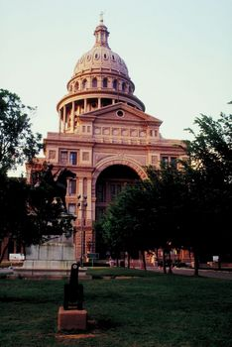
Origins of the Law
Common law
Legislatures
Courts

Slide 4
Age of Culpability
Juvenile: 10–16 years of age
Adult: 17 years of age and up

Slide 5
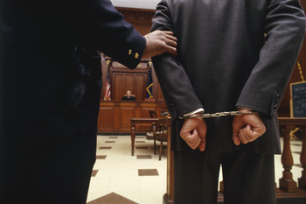
Crime Conviction Requirements
Proof beyond a reasonable doubt
All elements of an offense have to be proven

Slide 6
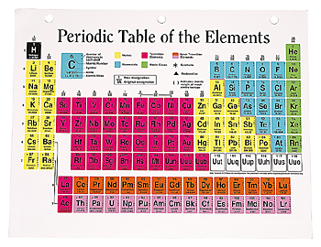
Elements of an Offense
Forbidden conduct – this is determined by the government
Culpable Mental State (CMS)
Any result
Negation of any exception

Slide 7
Culpable Mental States
The attitude someone has when committing a crime, their intentions

Slide 8
Culpable Mental States (continued)
There are four types of culpable mental states
Intentional – conscious objective
Knowing – aware with reasonable certainty

Slide 9
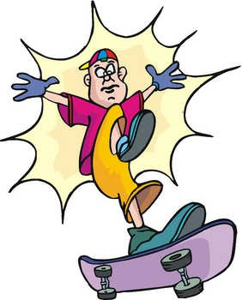
Culpable Mental States (continued)
There are four types of culpable mental states (continued)
Reckless – aware but conscious disregard of substantial and unjustifiable risk. Gross deviation from what a normal person would do.
Criminal Negligence – should have been aware of the risk but was not

Slide 10
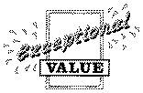
Instances When Crimes Go Without Punishment
Exceptions – when a law does not apply to a person the prosecutor must prove that the person does not have a reason to do what they are doing
Example – the penal code says an off-duty police officer can carry a sidearm without a permit

Slide 11
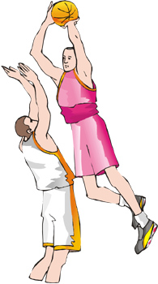
Instances When Crimes Go Without Punishment (continued)
Defense – the person has an excuse to commit the crime
The prosecutor does not have to negate the existence of the defense
The defendant must prove this exists
If it exists, the court shall charge that this is a reasonable doubt and the person must be acquitted

Slide 12
Instances When Crimes Go Without Punishment (continued)
Affirmative Defense – similar to a defense
The prosecutor does not have to negate the existence of the defense; it’s up to the defendant
It must be proved by a preponderance of the evidence
Example – sexual assault/statutory rape and the three-year exception, if the victim is at least 14 and it is consensual

Slide 13
General Defenses Used in Trial
Insanity
Affirmative defense
At the time of the conduct
Mental disease
Did not know the conduct was wrong

Slide 14
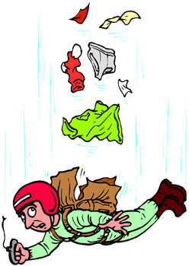
General Defenses Used in Trial (continued)
Mistake of Fact
Is a defense
The perception of the facts by the actor is mistaken
Has to be reasonable

Slide 15
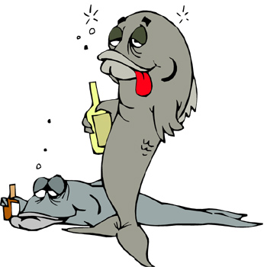
General Defenses Used in Trial (continued)
Mistake of Law – ignorance of a law is not an excuse for breaking that law
Intoxication – voluntary intoxication is not a defense

Slide 16
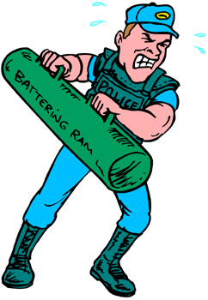
General Defenses Used in Trial (continued)
Duress
Affirmative defense
Not guilty if forced to commit the crime because of the threat of death or serious bodily injury to himself or another
Does not apply if the person intentionally, knowingly, or recklessly put himself in that position

Slide 17
General Defenses Used in Trial (continued)
Entrapment
Opportunity vs. persuasion
If the law enforcement officer induced the person to commit the crime then this defense applies
Examples – bait cars and undercover agents

Slide 18
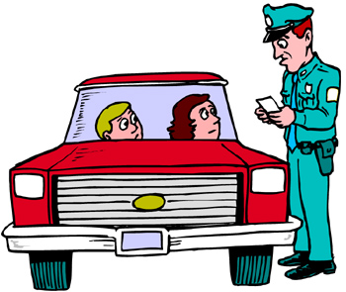
Punishments
Class C Misdemeanor
Fine not to exceed $500
Example – speeding ticket

Slide 19
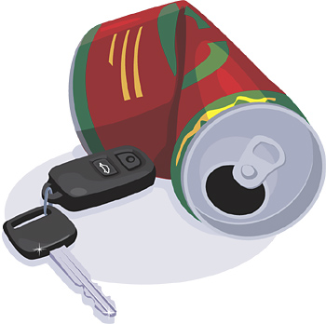
Punishments (continued)
Class B Misdemeanor
Fine not to exceed $2000
Up to 180 days in jail
Or both
Example – DWI

Slide 20
Punishments (continued)
Class A Misdemeanor
Fine not to exceed $4,000
Up to one year in jail
Or both
Example – burglary of a vehicle, assault

Slide 21
Punishments (continued)
State Jail Felony
Fine up to $10,000
180 days to two years in jail
Or both
Example – unauthorized use of a motor vehicle (stealing a car)

Slide 22
Punishments (continued)
Third Degree Felony
Fine up to $10,000
2 to 10 years in prison
Or both
Example – forging money

Slide 23
Punishments (continued)
Second Degree Felony
Fine up to $10,000
2 to 20 years in prison
Or both
Example – aggravated assault, robbery, burglary of a habitation, sexual assault

Slide 24
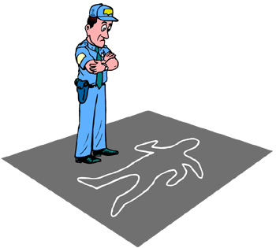
Punishments (continued)
First Degree Felony
Fine up to $10,000
5 to 99 years in prison
Or both
Example – murder, aggravated robbery, aggravated sexual assault

Slide 25
Punishments (continued)
Capital Felony
Life in prison or
Death penalty
Example – capital murder

Slide 26
Other Important Aspects
Criminal Attempt
When a person intentionally tries to commit a crime, an act beyond mere preparation, which tends to affect the commission of a crime
The punishment is one level below the crime the person is trying to commit
Example – attempted murder

Slide 27
Other Important Aspects (continued)
Criminal Conspiracy
An agreement between two or more persons to commit a felony and any member of the group commits an overt act
Overt act – any act that works towards the commission of the offense (the act is not necessarily a crime in and of itself).
The punishment is one level below the most serious crime planned

Slide 28
Resources
Texas Penal Code http://www.statutes.legis.state.tx.us/

