Slide 1
Effective Verbal Communication

Slide 2
Copyright and Terms of Service
Copyright © Texas Education Agency, 2011. These materials are copyrighted © and trademarked ™ as the property of the Texas Education Agency (TEA) and may not be reproduced without the express written permission of TEA, except under the following conditions:
1) Texas public school districts, charter schools, and Education Service Centers may reproduce and use copies of the Materials and Related Materials for the districts’ and schools’ educational use without obtaining permission from TEA.
2) Residents of the state of Texas may reproduce and use copies of the Materials and Related Materials for individual personal use only, without obtaining written permission of TEA.
3) Any portion reproduced must be reproduced in its entirety and remain unedited, unaltered and unchanged in any way.
4) No monetary charge can be made for the reproduced materials or any document containing them; however, a reasonable charge to cover only the cost of reproduction and distribution may be charged.
Private entities or persons located in Texas that are not Texas public school districts, Texas Education Service Centers, or Texas charter schools or any entity, whether public or private, educational or non-educational, located outside the state of Texas MUST obtain written approval from TEA and will be required to enter into a license agreement that may involve the payment of a licensing fee or a royalty.
Contact TEA Copyrights with any questions you may have.
Copyright © Texas Education Agency 2011. All rights reserved.
Images and other multimedia content used with permission.

Slide 3
Verbal Communication
Exchange of information
Information communicated through words
A verbal or written message
A process by which information is exchanged between individuals though a common system of symbols, signs, or behavior
Copyright © Texas Education Agency 2011. All rights reserved.
Images and other multimedia content used with permission.

Slide 4
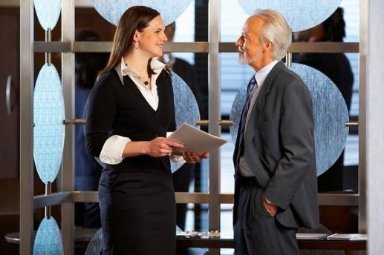
Why Communicate?
Establish and maintain relationships
Persuade and change attitudes or behavior
Develop an understanding of other people
Solve problems
Copyright © Texas Education Agency 2011. All rights reserved.
Images and other multimedia content used with permission.

Slide 5
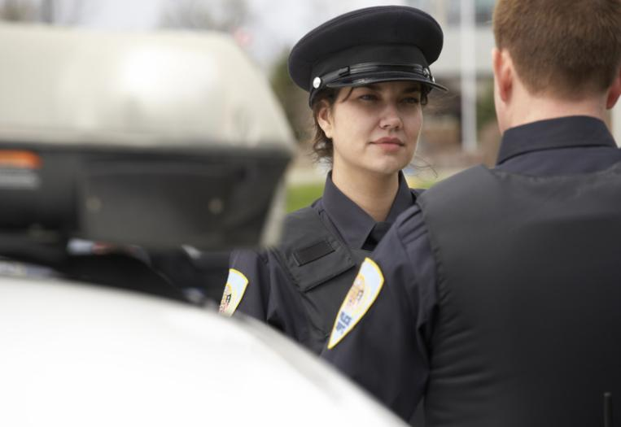
Uses of Verbal Communication in LPSCS Careers
Interactions with:
Public
Clients
Co-workers
Supervisors
Inmates
LPSCS Reports
Copyright © Texas Education Agency 2011. All rights reserved.
Images and other multimedia content used with permission.

Slide 6
Elements of Effective Communication
Speaker/Writer – creator of message
Message – transmitted information
Receiver – individual who analyzes and interprets the message
Feedback – verbal or nonverbal response the receiver sends to the speaker/writer
Copyright © Texas Education Agency 2011. All rights reserved.
Images and other multimedia content used with permission.

Slide 7
Elements of Effective Communication
Clear and Concise Message
Use understandable terms
Modify or define legal terms
Use proper grammar and pronunciation
Avoid slang and meaningless words
Moderate speed of speech
Correct spelling, punctuation, and grammar for written communications
Copyright © Texas Education Agency 2011. All rights reserved.
Images and other multimedia content used with permission.

Slide 8
Elements of Effective Communication
Message must be heard and received
Hearing or vision loss
Non-English speaker
Under the influence of an intoxicant
Consider alternate methods
Writing message out
Interpreter
Repeating message
Copyright © Texas Education Agency 2011. All rights reserved.
Images and other multimedia content used with permission.

Slide 9
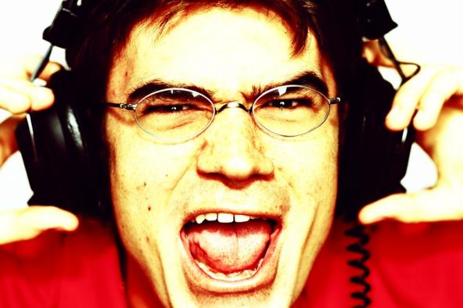
Elements of Effective Communication
Avoid interruptions or distractions
Phone
Weather
Noise from television
Noise from radio
Copyright © Texas Education Agency 2011. All rights reserved.
Images and other multimedia content used with permission.

Slide 10
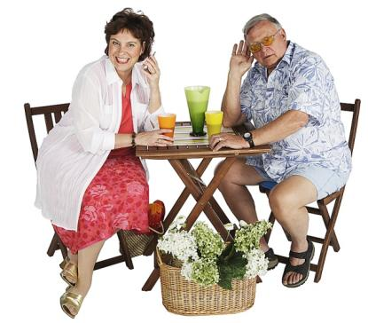
Barriers to Effective Communication
Hearing Loss
Use body language
Use short sentences
Face the receiver
Ensure hearing aids work properly
Get receiver’s attention before speaking
Do not chew gum or cover mouth
Copyright © Texas Education Agency 2011. All rights reserved.
Images and other multimedia content used with permission.

Slide 11
Barriers to Effective Communication
Impaired Vision
Describe what is happening
Announce arrival
Use touch
Use good light
Keep objects stationary
Announce departure
Copyright © Texas Education Agency 2011. All rights reserved.
Images and other multimedia content used with permission.

Slide 12
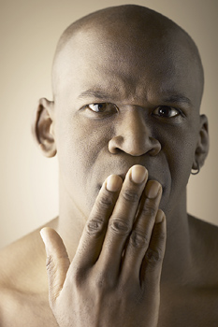
Barriers to Effective Communication
Trouble Speaking
Use Yes or No questions
Allow time to answer
Repeat answer for clarification
Encourage alternate methods of communication if necessary
Copyright © Texas Education Agency 2011. All rights reserved.
Images and other multimedia content used with permission.

Slide 13
Barriers to Effective Communication
Defense mechanisms
Compensation for another goal to achieve success
Denial
Displacement of anger
Projection
Rationalization
Copyright © Texas Education Agency 2011. All rights reserved.
Images and other multimedia content used with permission.

Slide 14
Effective Communication
Verbal messages must be clear, complete, concise, courteous, and cohesive
Nonverbal communication (body language) may change the message
Copyright © Texas Education Agency 2011. All rights reserved.
Images and other multimedia content used with permission.

Slide 15
Effective Listening
Involves both hearing and interpreting messages
Requires focusing on body language and the message being sent
May be passive or active
Active listening is very important in the LPSCS profession to gather information (for example, when interviewing a witness to a crime)
Copyright © Texas Education Agency 2011. All rights reserved.
Images and other multimedia content used with permission.

Slide 16
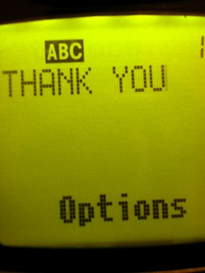
Copyright © Texas Education Agency 2011. All rights reserved.
Images and other multimedia content used with permission.

