Slide 1
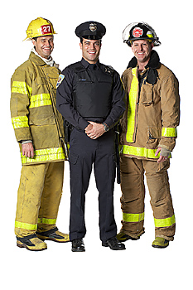
Teamwork and Leadership Skills in the Workplace
Practicum in LPSCS

Slide 2
Copyright and Terms of Service
Copyright © Texas Education Agency, 2011. These materials are copyrighted © and trademarked ™ as the property of the Texas Education Agency (TEA) and may not be reproduced without the express written permission of TEA, except under the following conditions:
1) Texas public school districts, charter schools, and Education Service Centers may reproduce and use copies of the Materials and Related Materials for the districts’ and schools’ educational use without obtaining permission from TEA.
2) Residents of the state of Texas may reproduce and use copies of the Materials and Related Materials for individual personal use only, without obtaining written permission of TEA.
3) Any portion reproduced must be reproduced in its entirety and remain unedited, unaltered and unchanged in any way.
4) No monetary charge can be made for the reproduced materials or any document containing them; however, a reasonable charge to cover only the cost of reproduction and distribution may be charged.
Private entities or persons located in Texas that are not Texas public school districts, Texas Education Service Centers, or Texas charter schools or any entity, whether public or private, educational or non-educational, located outside the state of Texas MUST obtain written approval from TEA and will be required to enter into a license agreement that may involve the payment of a licensing fee or a royalty.
Contact TEA Copyrights with any questions you may have.
Copyright © Texas Education Agency 2011. All rights reserved.
Images and other multimedia content used with permission.

Slide 3
Benefits of Teamwork
Increased motivation
Increased morale
Improved product quality
Improved customer service
Improved communication
Greater job satisfaction
Improved self-esteem
Copyright © Texas Education Agency 2011. All rights reserved.
Images and other multimedia content used with permission.

Slide 4
Types of Teams
Functional – people from one department working together to reach a common goal
Cross-functional – people from two or more departments working together to reach a common goal
Self-directed – a team responsible for choosing its own methods for reaching its goals, working without outside supervision
Copyright © Texas Education Agency 2011. All rights reserved.
Images and other multimedia content used with permission.
4

Slide 5
Team Planning
Setting goals
Assigning roles and duties
Communicating
Copyright © Texas Education Agency 2011. All rights reserved.
Images and other multimedia content used with permission.
5

Slide 6
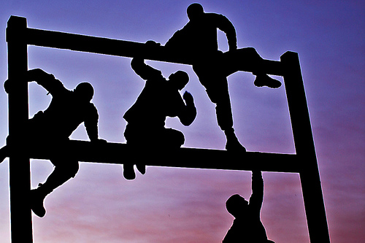
Potential Obstacles to Teamwork
Unclear goals
Misunderstandings about a team’s authority
Unclear plans to assess individual performance
Competitiveness among team members
Resentment over lack of individual recognition
Copyright © Texas Education Agency 2011. All rights reserved.
Images and other multimedia content used with permission.
6

Slide 7
Being an Effective Team Member
Make the team’s goal your top priority
Listen actively in meetings and offer suggestions
Follow through on your assigned tasks
Work to resolve conflicts among team members
Inspire coworkers to get involved and do their best
Copyright © Texas Education Agency 2011. All rights reserved.
Images and other multimedia content used with permission.
7

Slide 8
Leadership Qualities
Good communication
Vision
Involving others
Being a role model
Being decisive
Being positive
Problem-solving
Copyright © Texas Education Agency 2011. All rights reserved.
Images and other multimedia content used with permission.
8

Slide 9
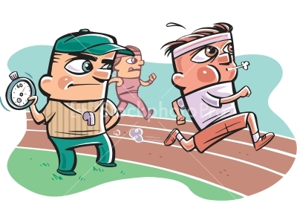
Leadership Styles
Directing
Coaching
Supporting
Delegating
Copyright © Texas Education Agency 2011. All rights reserved.
Images and other multimedia content used with permission.
9

Slide 10
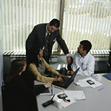
Leadership Tips
Provide sufficient training
Give clear directions
Know when to intervene
Don’t be afraid to admit mistakes
Be consistent
Treat others fairly
Praise in public, reprimand in private
Make your expectations clear
Copyright © Texas Education Agency 2011. All rights reserved.
Images and other multimedia content used with permission.
10

Slide 11
Resources
9780078748288, Succeeding in the World of Work, Kimbrell, McGraw-Hill, 2008. (Ch. 14)
9780538444026, Working, Bailey, South-Western, 2007. (Ch. 18)
Copyright © Texas Education Agency 2011. All rights reserved.
Images and other multimedia content used with permission.

