Slide 1
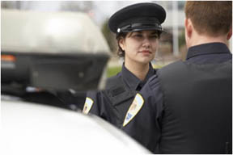
Code of Ethics Law Enforcement I

Slide 2
Copyright and Terms of Service
Copyright © Texas Education Agency, 2011. These materials are copyrighted © and trademarked ™ as the property of the Texas Education Agency (TEA) and may not be reproduced without the express written permission of TEA, except under the following conditions:
1) Texas public school districts, charter schools, and Education Service Centers may reproduce and use copies of the Materials and Related Materials for the districts’ and schools’ educational use without obtaining permission from TEA.
2) Residents of the state of Texas may reproduce and use copies of the Materials and Related Materials for individual personal use only, without obtaining written permission of TEA.
3) Any portion reproduced must be reproduced in its entirety and remain unedited, unaltered and unchanged in any way.
4) No monetary charge can be made for the reproduced materials or any document containing them; however, a reasonable charge to cover only the cost of reproduction and distribution may be charged.
Private entities or persons located in Texas that are not Texas public school districts, Texas Education Service Centers, or Texas charter schools or any entity, whether public or private, educational or non-educational, located outside the state of Texas MUST obtain written approval from TEA and will be required to enter into a license agreement that may involve the payment of a licensing fee or a royalty.
Contact TEA Copyrights with any questions you may have.

Slide 3
Police and Society
The mission of law enforcement while protecting a democratic society:
To fight crime
To serve and protect
To promote public safety
To enforce the law
To provide “due process” and “equal protection” for all

Slide 4
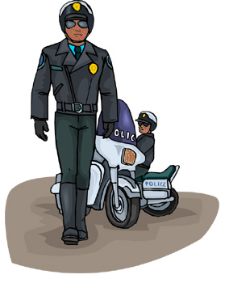
Police and Society (continued)
The police
Work for citizens of the community they are employed by
Have the duty to protect the community, even to the point of death
What are the benefits of good police service to the community?

Slide 5
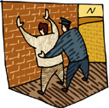
Police and Society (continued)
Police officers have tremendous power in our society:
The power to arrest
The power to mediate or to charge
The power to use force
The power of life and death

Slide 6
Police and Society (continued)
Police Authority
Entitlement to unquestioned obedience that derives from fulfilling a specific role
The officer has power simply because he or she is a police officer
Police Power
Power is the means to dominate others
The term “power” implies that there might be resistance to overcome

Slide 7
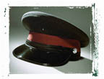
Police and Society (continued)
According to Social Contract Theory
Each person gives up complete freedom in exchange for the guaranteed protection of the society against others
Police power is part of this quid pro quo
Police power exists to provide protection
Since police power may also violate protection if abused, it is limited to what is necessary for protection

Slide 8
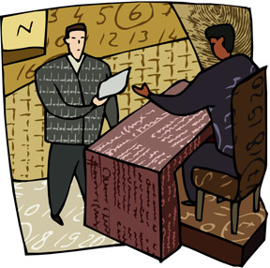
The Role of the U.S. Constitution in Police Work
The United States Constitution offers protections to citizens from unreasonable intrusions in their life by law enforcement
Police officials must have exceptions to violate these protections and these exceptions must be proven in court
Reasonable suspicion
Probable cause
Warrant signed by a judge

Slide 9
The Role of the U.S. Constitution in Police Work (continued)
Rules and laws in relation to police officials and the U.S. Constitution are defined in court cases, and their application to law enforcement is ever changing
This separation of powers in the criminal justice field maintains the integrity of the system while protecting innocent people from corrupt officers

Slide 10
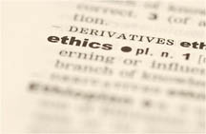
Ethics in Law Enforcement
What is ethics?
A code of values which guides our choices and determines the purposes and courses of our lives

Slide 11
Ethics in Law Enforcement (continued)
Why are ethics important in law enforcement?
Career survival
Media coverage
Community view of agency
In-house dissension
Personal stress
Innocent people can suffer

Slide 12
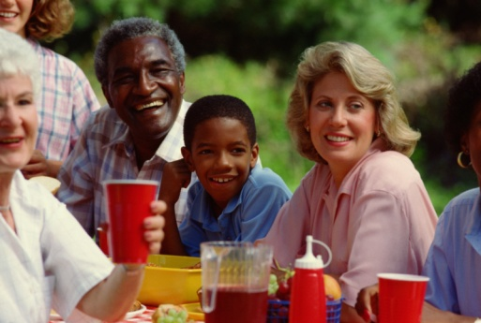
Ethics in Law Enforcement (continued)
Where do we get our ethics from?
Our upbringing
School
Religion
Friends
Society as a whole

Slide 13
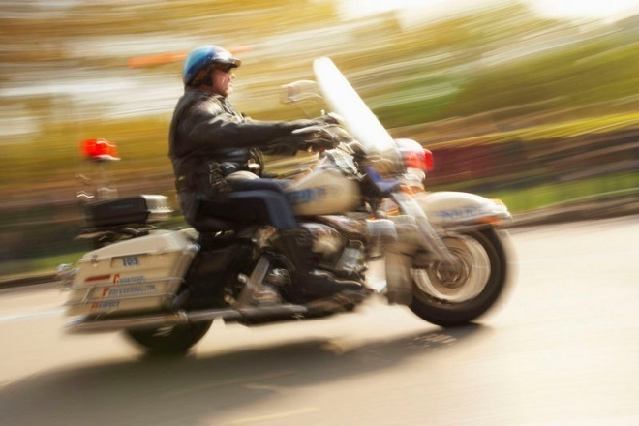
Threats to Ethical Conduct
Corruption
Exploiting one’s position for personal gain at the expense of those one is authorized to serve
Police corruption is a worldwide problem

Slide 14
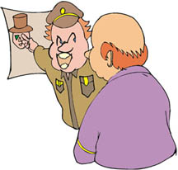
Threats to Ethical Conduct (continued)
Noble Cause Corruption
Involves officers employing unethical means to catch criminals because “it’s the right thing to do”
Perceived by officers as a fulfillment of their profound moral commitment to make the world a safer place to live

Slide 15
Threats to Ethical Conduct (continued)
Discrimination
Occurs when a discretionary decision-maker treats a group or individual differently from others for no justifiable reason
Individual prejudices and perceptions of groups may influence an officer’s decisions
Everyone has a prejudice, we just need to identify what it is and not act on it

Slide 16
Threats to Ethical Conduct (continued)
Graft
Exploitation of one’s role by accepting bribes or protection money
Excessive Force
Occurs when an officer goes beyond what is necessary for arrest, or has no lawful reason to use force at all but does

Slide 17
Threats to Ethical Conduct (continued)
Racial Profiling
Stopping an individual based solely on racial characteristics

Slide 18
Other Ethical Issues
Duty
The responsibilities attached to a specific role
It is important for officers to properly understand their role in society so citizen’s constitutional rights are not violated

Slide 19
Other Ethical Issues (continued)
Discretion
The option to choose between two or more courses of behavior
Gratuities
Items of value given because of role or position, rather than because of a personal relationship

Slide 20
Other Ethical Issues (continued)
Police Subculture
An unofficial fraternity of police officers that promotes an “us versus them” mentality because they
Typically form a homogenous social group
Have a uniquely stressful work environment
Participate in a basically closed social system

Slide 21
Other Ethical Issues (continued)
Characteristics of Police Subculture
Cynical
Isolated, alienated
Defensive, distrustful
Authoritarian, dogmatic
More conservative than the general public
Value equality less than the general public
Value obedience over independence

Slide 22
Types of Corrupt Officers
Grass eaters
Passively corrupt
Opportunistic ethical violations
Take bribes and gratuities
Accept unsolicited protection money

Slide 23
Types of Corrupt Officers (continued)
Meat eaters
Actively corrupt
Regular ethical violations
Participate in shakedowns
Rob drug dealers
“Shop" at burglary scenes
Engage in criminal activities

Slide 24
Police Discipline
Internal Affairs
An internal discipline system where police investigate themselves
This may be a separate division within the department, or cases may be given to supervisors to investigate as complaints arise

Slide 25
Police Discipline (continued)
Internal Affairs
The assigned investigators follow up on reports by citizens and other officers about other officers’ misbehavior or unethical choices
Sometimes a committee is formed that will make a recommendation to the chief on what the punishment should be for the officer found guilty of unethical behavior

Slide 26
Ethical Decision-making
Every decision we make should be assessed through application of the following questions:
Is it legal?
Is it fair to all concerned?
How will the decision make me feel about myself?

Slide 27
Ethical Decision-making (continued)
Other standards to guide a law enforcement professional’s decision making
The Bell – are there warnings in your head?
The Book – are there any codes being violated? (penal code, CCP, SOPs)
The Candle – will the decision withstand public scrutiny?

Slide 28
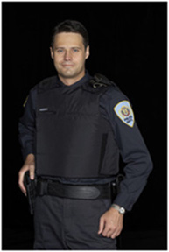
Enhancing Public Trust
What are some ways that the police can enhance the public’s trust in them?

Slide 29
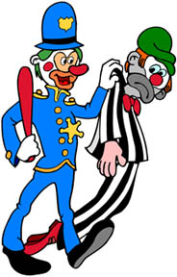
Enhancing Public Trust (continued)
A tough hiring process with high qualifications helps weed out the potential bad future employees from the good

Slide 30
Enhancing Public Trust (continued)
Qualifications include
Clean or limited criminal record
Good work history
Lack of or limited history of drug abuse
At least some college education or military experience

Slide 31
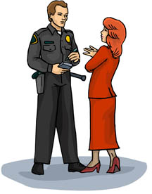
Enhancing Public Trust (continued)
A good hiring process includes
Extensive background investigation
Polygraph test
Oral review board
Psychological examination
Physical examination

Slide 32
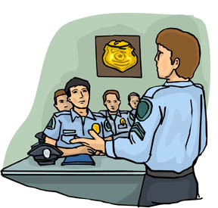
Enhancing Public Trust (continued)
Good training brings ethical issues to light and reminds officers of what to be aware of. This can happen in
Police academy
Field training
In-service training

Slide 33
Enhancing Public Trust (continued)
Other ways to reduce corruption
Increase pay
Eliminate unenforceable laws
Establish civilian review boards
Improve leadership

Slide 34
Enhancing Public Trust (continued)
Other ways to reduce corruption
Set realistic goals and objectives
Provide a written code of ethics
Provide a whistle-blowing procedure that ensures fair treatment for all parties
Rotate assignments

Slide 35
Enhancing Public Trust (continued)
Civilian Review/Complaint Model Discipline Approach
An independent civilian agency audits complaints and investigations
Police still investigate and conduct the discipline proceeding
This can provide more transparency and trust with the department and the public

Slide 36
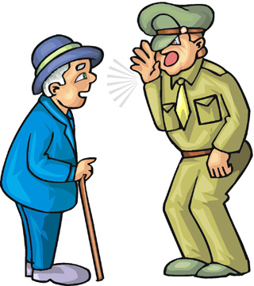
Police and Ethics Conclusion
Nearly every decision a law enforcement officer makes is an ethical one and can have long lasting consequences in society, for good or bad

Slide 37
Resources
020547893X, Fagin, James. Criminal Justice: Prentice Hall, 2007.
Texas Commission on Law Enforcement Officers Standards and Education (TCLOESE) Training
Officer’s experience on-the-job

