Slide 1
Working With Imported Geometry:
Principles of Model Meshing for Simulation
Discuss the principles of model meshing
Overview on the types of elements and the advantages and disadvantages of each
Reasons for locally refining a mesh
Stress resolution and its dependency on mesh density
Notes:
Discuss the principles of model meshing
Overview on the types of elements and the advantages and disadvantages of each
Reasons for locally refining a mesh
Stress resolution and its dependency on mesh density

Slide 2
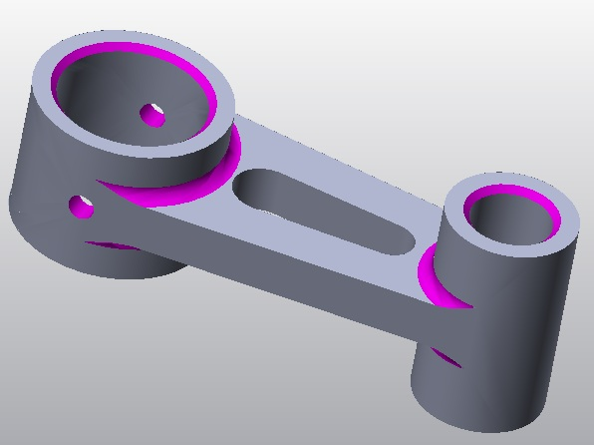
Working With Imported Geometry Principles of Model Meshing for Simulation Overview
Section 1
Module 7
Page 1
In order to determine the displacements, stresses, and strains in a component or assembly using FEA, the model must first be broken down into what are called “finite elements.”
A default mesh is often sufficient, but occasionally refinement is necessary due to:
Small features or holes in areas of high stress
Thin-walled geometry
High aspect ratios
Notes:
In order to determine the displacements, stresses, and strains in a component or assembly using FEA, the model must first be broken down into what are called “finite elements.”
A default mesh is often sufficient, but occasionally refinement is necessary:
Small features or holes in areas of high stress
Thin-walled geometry
High aspect ratios

Slide 3
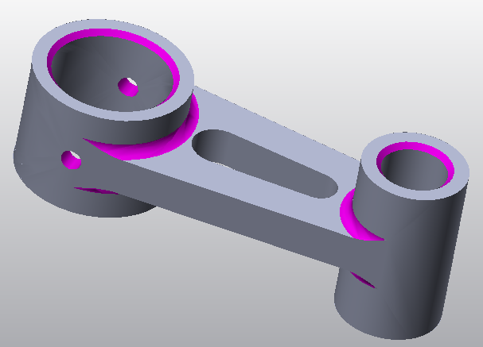
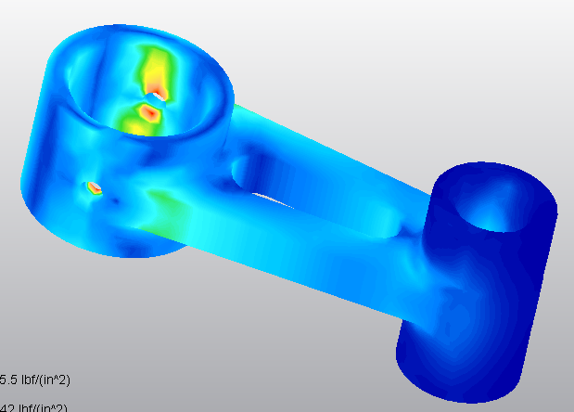
Working With Imported Geometry Principles of Model Meshing for Simulation Location of mesh refinements
Section 1
Module 7
Page 2
Small features, like fillets, chamfers, and small holes (as shown in upper image in purple), automatically increase the mesh density, so these features can be deleted if they are in low stress areas (fillets and chamfers in this model).
Around the hole, however, the mesh density is too low, and only a few nodes are involved in determining the maximum stress around the small hole (shown in red in the lower image).
Localized mesh refinement is needed around the small hole.
Notes:
Small features, like fillets, chamfers, and small holes (as shown in upper image in purple), automatically increase the mesh density, so these features can be deleted if they are in low stress areas (fillets and chamfers in this model).
Around the hole, however, the mesh density is too low, and only a few nodes are involved in determining the maximum stress around the small hole (shown in red in the lower image).
Localized mesh refinement is needed around the small hole

Slide 4
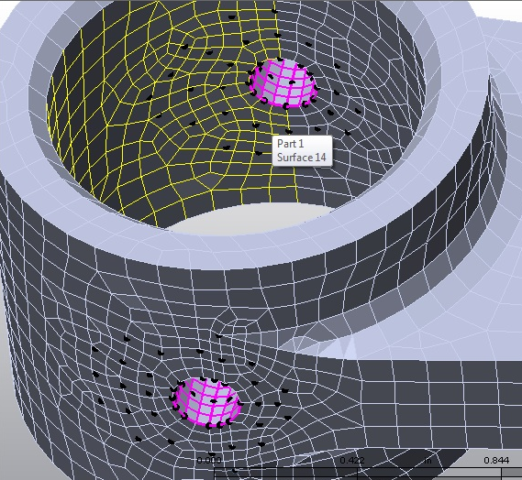
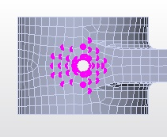
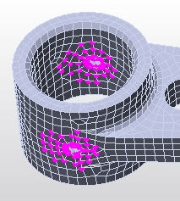
Working With Imported Geometry Principles of Model Meshing for Simulation Mesh generation
Section 1
Module 7
Page 3
It is always possible to simply increase the mesh density of the entire part, but this significantly increases the number of nodes and will make the analysis take much longer or even exceed the number of nodes available.
Alternatively, a refinement only increases the node density in targeted regions.
Notes:
It is always possible to simply increase the mesh density of the entire part, but this significantly increases the number of nodes and will make the analysis take much longer or even exceed the number of nodes available.
Alternatively, a refinement only increases the node density in targeted regions

Slide 5
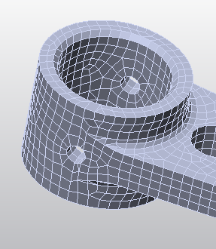
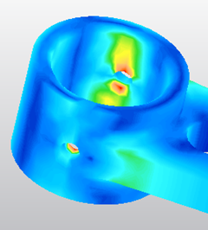
Working With Imported Geometry Principles of Model Meshing for Simulation Resolving stress using mesh refinement
Section 1
Module 7
Page 4
In FEA software, the displacement values stabilize and resolve to their final maximums with even a very coarse mesh, but stress values DO NOT!
It may take several iterations of mesh refinement around a region of high stress until the stress values plateau at their maximum. This is because the element size is just too large to detect the variation in stress between neighboring nodes, and the peak stress may be in between.
The maximum stress reported around the hole in the yoke at the right is 18,000 psi.
Notes:
In FEA software, the displacement values stabilize and resolve to their final maximums with even a very coarse mesh, but stress values DO NOT!
It may take several iterations of mesh refinement around a region of high stress until the stress values plateau at their maximum. This is because the element size is just too large to detect the variation in stress between neighboring nodes, and the peak stress may be in between.
The maximum stress reported around the hole in the yoke at the right is 18,000 psi

Slide 6
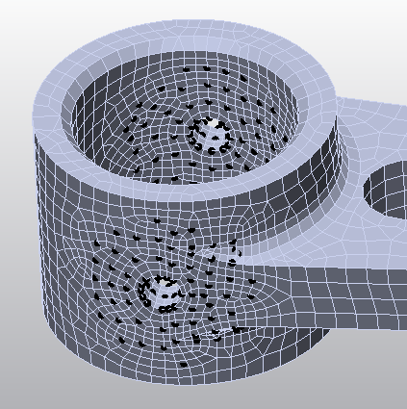
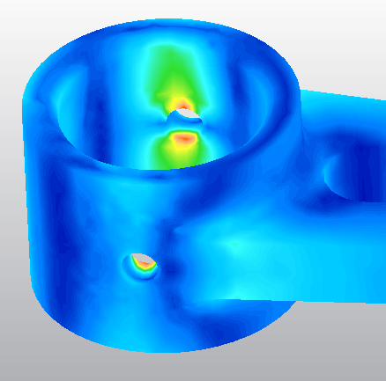
Working With Imported Geometry Principles of Model Meshing for Simulation Results of mesh refinement on stress
Section 1
Module 7
Page 5
Using a circular selection tool, all the nodes around the small hole were selected and refinement points were added. The black dots show where the node vertices used to be.
The overall mesh density of the part is identical to the previous slide, but the FEA software has automatically created a transition zone to the region of higher mesh density.
Upon analysis, the peak stress is now reported as 25,000 psi, and the area of peak stress has been reduced.
Notes:
Using a circular selection tool, all the nodes around the small hole were selected and refinement points were added. The black dots show where the node vertices used to be.
The overall mesh density of the part is identical to the previous slide, but the FEA software has automatically created a transition zone to the region of higher mesh density.
Upon analysis, the peak stress is now reported as 25,000 psi, and the area of peak stress has been reduced.

Slide 7
Working With Imported Geometry Principles of Model Meshing for Simulation Iteration and other pitfalls
Section 1
Module 7
Page 6
To successfully analyze a part or assembly, it is imperative that the analyst iterate on the stress values by locally refining the mesh around stress concentrations.
For complex geometry with many regions of high stress, it may be easier to increase the overall mesh density.
Notes:
To successfully analyze a part or assembly, it is imperative that the analyst iterate on the stress values by locally refining the mesh around stress concentrations.
For complex geometry with many regions of high stress, it may be easier to increase the overall mesh density.

Slide 8
Working With Imported Geometry Principles of Model Meshing for Simulation Iteration and other pitfalls
Section 1
Module 7
Page 7
NOTE: Brick elements are “higher order” elements and will resolve to the maximum stress values more quickly than tetrahedral elements. However, in highly complex geometry, brick elements become distorted, and only tetrahedral elements can be used.
Stress values will always vary slightly with each iteration, so the goal is to see the values plateau, with only a small percentage change from the previous iteration.
Notes:
NOTE: Brick elements are “higher order” elements and will resolve to the maximum stress values more quickly than tetrahedral elements. However, in highly complex geometry, brick elements become distorted, and only tetrahedral elements can be used.
Stress values will always vary slightly with each iteration, so the goal is to see the values plateau, with only a small percentage change from the previous iteration.

Slide 9
Working With Imported Geometry Principles of Model Meshing for Simulation Summary
Section 1
Module 7
Page 8
Discuss the principles of model meshing
Overview on the types of elements and the advantages and disadvantages of each
Reasons for locally refining a mesh
Stress resolution and its dependency on mesh density
The video will demonstrate how to mesh a CAD model in Autodesk® Simulation Multiphysics.
After running a first analysis, the mesh will be refined around a region of high stress, and the analysis will be run a second time to demonstrate how the stresses change.
Notes:
Discuss the principles of model meshing
Overview on the types of elements and the advantages and disadvantages of each
Reasons for locally refining a mesh
Stress resolution and its dependency on mesh density
The video will demonstrate how to mesh a CAD model in Autodesk® Simulation Multiphysics.
After running a first analysis, the mesh will be refined around a region of high stress, and the analysis will be run a second time to demonstrate how the stresses change

