Slide 1
Working With Imported Geometry:
Editing Non-Native Imported Geometry
How to edit CAD models using Autodesk® Inventor® Fusion
How to split a surface to apply loads and boundary conditions
Eliminating chamfers, fillets, and small features
Notes:
How to edit CAD models using Autodesk® Inventor® Fusion
How to split a surface to apply loads and boundary conditions
Eliminating chamfers, fillets, and small features

Slide 2
Working With Imported Geometry Editing Non-Native Imported Geometry Overview
Section 1
Module 2
Page 1
Sometimes, when a part or assembly is imported from CAD into FEA, edits are necessary.
Edits can be made within the original CAD package, within Autodesk Inventor Fusion, or within the FEA software.
Common edits that are needed include:
Changes in surface split locations
Removal of fillets or chamfers
Removal of small features
In the case of small features, removal is necessary to make the model easier to mesh and to reduce the number of elements, making the model run faster and with fewer geometry errors.
Notes:
Sometimes, when a part or assembly is imported from CAD into FEA, edits are necessary.
Edits can be made within the original CAD package, within Autodesk Inventor Fusion, or within the FEA software.
Common edits that are needed include:
Changes in surface split locations
Removal of fillets or chamfers
Removal of small features
In the case of small features, removal is necessary to make the model easier to mesh and to reduce the number of elements, making the model run faster and with fewer geometry errors.

Slide 3
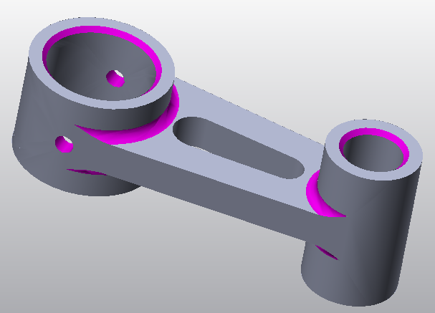
Working With Imported Geometry Editing Non-Native Imported Geometry Fillets and chamfers
Section 1
Module 2
Page 2
For analysis of a part, such as the yoke shown, many simplifying assumptions should be considered:
Are the chamfers and fillets necessary?
Can the hole be eliminated?
Notes:
For analysis of a part, such as the yoke shown, many simplifying assumptions should be considered:
Are the chamfers and fillets necessary?
Can the hole be eliminated?

Slide 4
Working With Imported Geometry Editing Non-Native Imported Geometry Fillets and chamfers
Section 1
Module 2
Page 3
The steps for analyzing a part by hand or in FEA are basically the same:
Determine the material out of which the part will be made and use those material properties.
Determine the magnitude and direction of the load and apply it.
Determine how the part will be constrained.
Consider the elimination of small features.
Perform the analysis.
Notes:
The steps for analyzing a part by hand or in FEA are basically the same:
Determine the material out of which the part will be made and use those material properties.
Determine the magnitude and direction of the load and apply it.
Determine how the part will be constrained.
Consider the elimination of small features.
Perform the analysis.

Slide 5
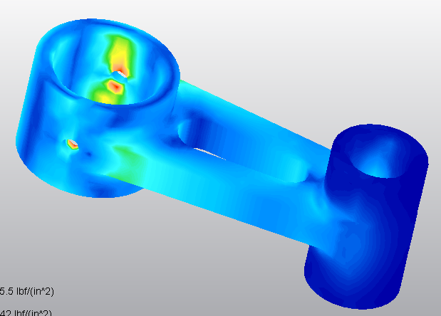
Working With Imported Geometry Editing Non-Native Imported Geometry Small features and stress concentrations
Section 1
Module 2
Page 4
Small features, like fillets, chamfers, and small holes (as shown in upper image in purple), can greatly increase the mesh density of a part, thus increasing the time required to analyze.
Many of these small features can be eliminated, but some are located in places where there are stress concentrations, such as can be seen for the small hole in the lower image. The small hole should not be eliminated from the analysis.
Notes:
Small features, like fillets, chamfers, and small holes (as shown in upper image in purple), can greatly increase the mesh density of a part, thus increasing the time required to analyze.
Many of these small features can be eliminated, but some are located in places where there are stress concentrations, such as can be seen for the small hole in the lower image. The small hole should not be eliminated from the analysis.

Slide 6
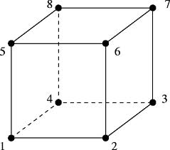
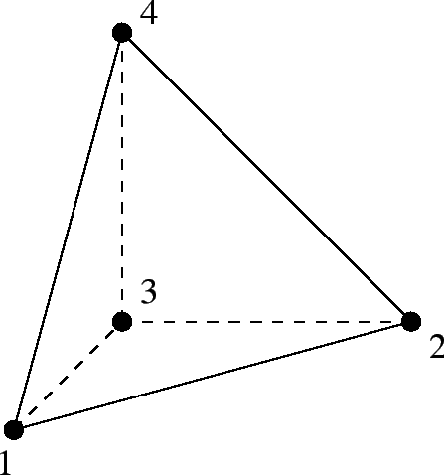
Working With Imported Geometry Editing Non-Native Imported Geometry Types of elements
Section 1
Module 2
Page 5
For FEA, the part must also be broken up into small pieces, called “finite elements”, and there are various different shapes of these elements for different purposes.
For solid geometry, the most common shape is brick, which is a six-sided shape resembling a box made out of rods. The other is a tetrahedron, which is a four-sided triangle made of rods.
At the end of each “rod” on the corner, there is a node.
Notes:
For FEA, the part must also be broken up into small pieces, called “finite elements”, and there are various different shapes of these elements for different purposes.
For solid geometry, the most common shape is brick, which is a six-sided shape resembling a box made out of rods. The other is a tetrahedron, which is a four-sided triangle made of rods.
At the end of each “rod” on the corner, there is a node.

Slide 7
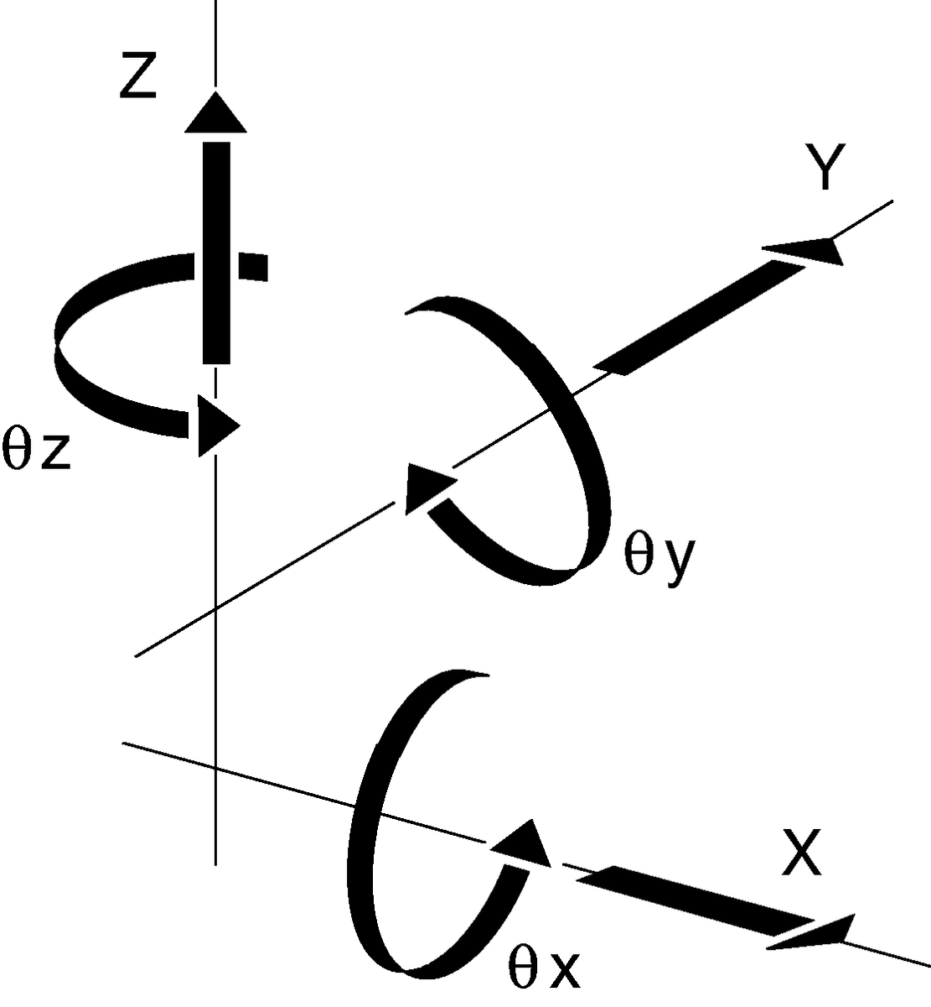
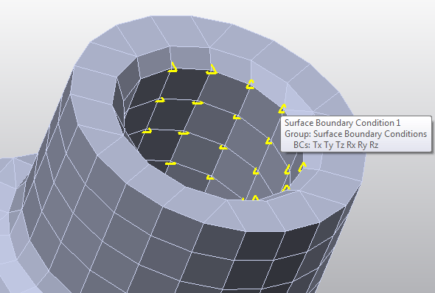
Working With Imported Geometry Editing Non-Native Imported Geometry Boundary conditions and degrees of freedom
Section 1
Module 2
Page 6
Boundary conditions are a way of constraining the part so it doesn’t “fly away” because of the applied load.
There are six degrees of freedom, three translations and three rotations.
If all six degrees of freedom are constrained, the nodes are said to be “fixed.” Autodesk® Simulation Multiphysics represents this as a green triangle on each node. Anything less than six is a green circle.
Notes:
Boundary conditions are a way of constraining the part so it doesn’t “fly away” because of the applied load.
There are six degrees of freedom, three translations and three rotations.
If all six degrees of freedom are constrained, the nodes are said to be “fixed.” Autodesk® Simulation Multiphysics represents this as a green triangle on each node. Anything less than six is a green circle.

Slide 8
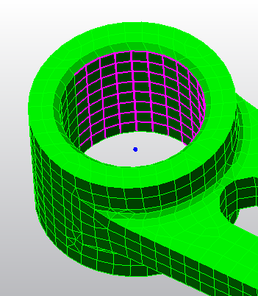
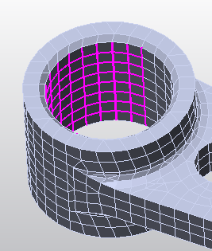
Working With Imported Geometry Editing Non-Native Imported Geometry Surfaces: Applying surface splits, loads, and boundary conditions
Section 1
Module 2
Page 7
Loads and boundary conditions are applied to nodes, but most FEA packages allow the user to select surfaces, as this makes more intuitive sense.
Sometimes, the surface is not split in the desired direction and thus needs editing.
Surfaces can be split within the FEA package, within Autodesk® Inventor® Fusion, or within the original CAD package.
To split a surface, construction geometry is often needed to create a split plane.
Notes:
Loads and boundary conditions are applied to nodes, but most FEA packages allow the user to select surfaces, as this makes more intuitive sense.
Sometimes, the surface is not split in the desired direction and thus needs editing.
Surfaces can be split within the FEA package, within Autodesk® Inventor® Fusion, or within the original CAD package.
To split a surface, construction geometry is often needed to create a split plane.

Slide 9
Working With Imported Geometry Editing Non-Native Imported Geometry Summary
Section 1
Module 2
Page 8
How to edit CAD models using Autodesk® Inventor® Fusion
How to split a surface to apply loads and boundary conditions
Eliminating chamfers, fillets, and small features
The video will demonstrate how to edit a CAD model using Autodesk® Inventor® Fusion and then importing it into Autodesk® Simulation Multiphysics.
The Autodesk® Inventor® CAD file will be used to show how to create a surface split.
Notes:
How to edit CAD models using Autodesk® Inventor® Fusion
How to split a surface to apply loads and boundary conditions
Eliminating chamfers, fillets, and small features
The video will demonstrate how to edit a CAD model using Autodesk® Inventor® Fusion and then importing it into Autodesk® Simulation Multiphysics.
The Autodesk® Inventor® CAD file will be used to show how to create a surface split.

